Slide 1
ER-1
4

Slide 2
Contents
Entity Relationship(ER) diagram
ER Diagram Symbols

Slide 3
Entity Relationship(ER) diagram
ER diagram or Entity Relationship diagram is a conceptual model that gives the graphical representation of the logical structure of the database.
It shows all the constraints and relationships that exist among the different components.

Slide 4
Example
Roll_no | Name | Age
1 | Akshay | 20
2 | Rahul | 19
3 | Pooja | 20
4 | Aarti | 19
This complete table is referred to as “Student Entity Set” and each row represents an “entity”.

Slide 5
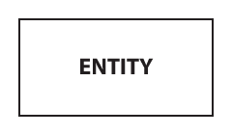
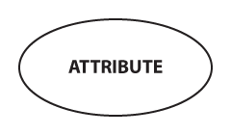
Representation of Entity and Attributes
An entity is represented by a rectangle which contains the entity’s name.
In the Chen notation, each attribute is represented by an oval containing attribute's name:

Slide 6
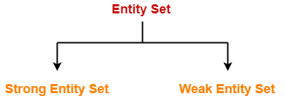
Representation of Entity and Attributes
In the Chen notation, we distinguish types of entities:

Slide 7

Representation of Entity and Attributes
A strong entity set is an entity that contains sufficient attributes to uniquely identify all its entities.
Simply strong entity is nothing but an entity set having a primary key attribute or a table which consists of a primary key column.
The primary key of the strong entity is represented by underlining it. The strong entity is represented by a single rectangle.
The primary key attribute of the strong entity is represented by underlining it.

Slide 8
Representation of Entity and Attributes
A weak entity is an entity set that does not have sufficient attributes for Unique Identification of its records.
Simply a weak entity is nothing but an entity which does not have a primary key attribute.
It contains a partial key called as discriminator which helps in identifying a group of entities from the entity set.

Slide 9
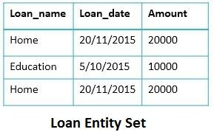
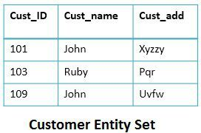
Representation of Entity and Attributes
The discriminator or partial key of a weak entity set is a set of attributes that allow the distinction to be made. It is created by a primary key of strong entity/owner entity/identifying entity plus the partial key of the weak entity set.
Primary key of loan: Loan_name + Cust_ID

Slide 10
Difference between Strong Entity and Weak Entity
Key Differences Between Strong Entity and Weak Entity
The basic difference between strong entity and a weak entity is that the strong entity has a primary key whereas, a weak entity has the partial key which acts as a discriminator between the entities of a weak entity set.
A weak entity always depends on the strong entity for its existence whereas, a strong entity is independent of any other entity’s existence.
A strong entity is denoted with a single rectangle and a weak entity is denoted with a double rectangle.
The relationship between two strong entities is denoted with single diamond whereas, a relationship between a weak and a strong entity is denoted with double diamond called Identifying Relationship.
The strong entity may or may not show the total participation in its relations, but the weak entity always shows total participation in the identifying relationship which is denoted by the double line.

Slide 11
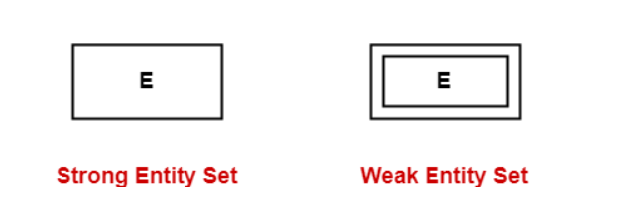
Representation of Entity and Attributes

Slide 12
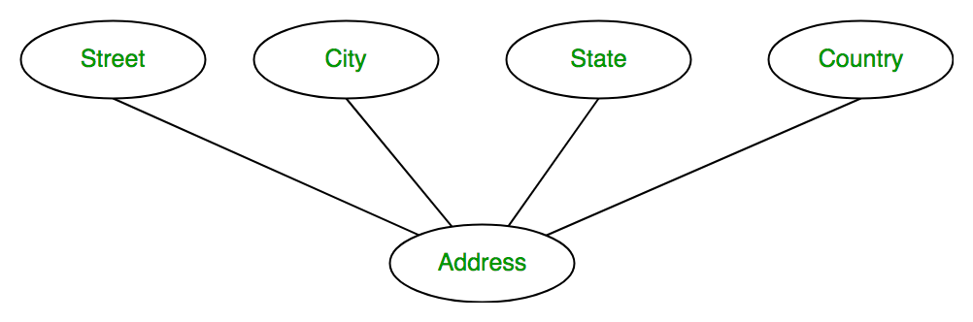
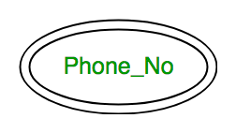
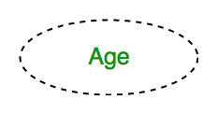
Representation of Entity and Attributes
If the attributes are composite, they are further divided in a tree like structure.
An attribute consisting more than one value (Multivalued Attribute) for a given entity. For example, Phone_No [represented by double oval]
An attribute which can be derived from other attributes of the entity type is known as derived attribute. e.g.; Age [represented by dashed oval]

Slide 13
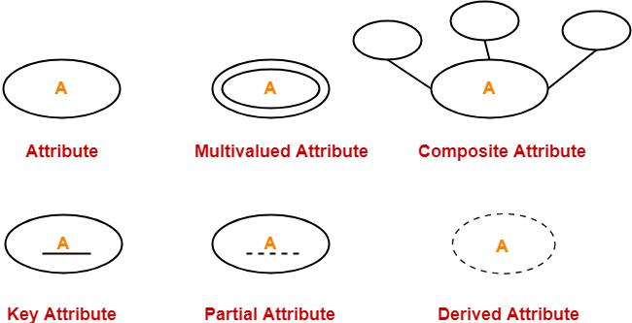
Attribute representation

Slide 14
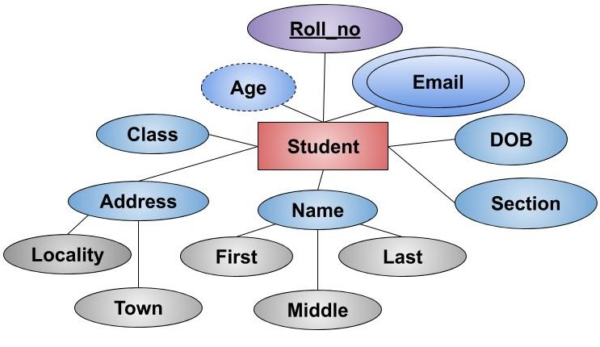
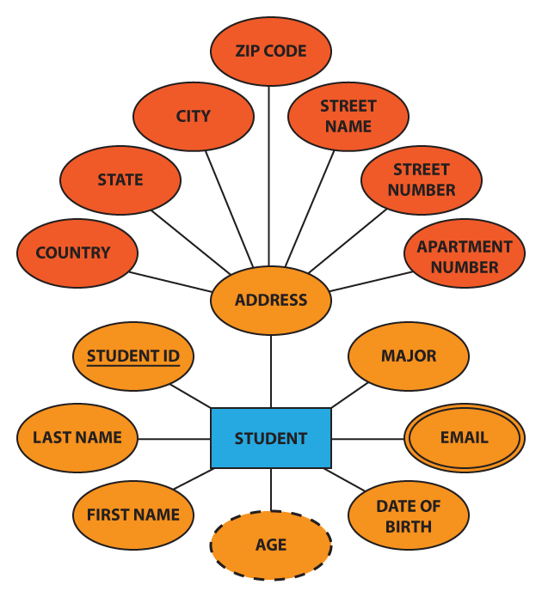
Representation of Entity and Attributes

Slide 15
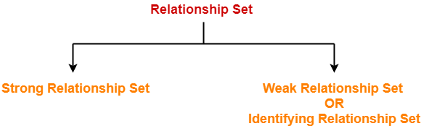
Relationship Sets
Relationship defines an association among several entities.
A relationship set is a set of same type of relationships.

Slide 16
Relationship Sets
Strong Relationship Set-
A strong relationship exists between two strong entity sets.
It is represented using a diamond symbol.
Weak Relationship Set-
A weak or identifying relationship exists between the strong and weak entity set.
It is represented using a double diamond symbol.

Slide 17
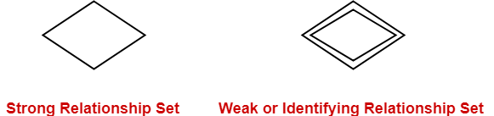
Relationship Sets

Slide 18
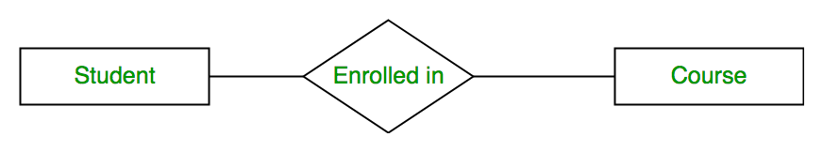
E-R diagram for student and course

Slide 19
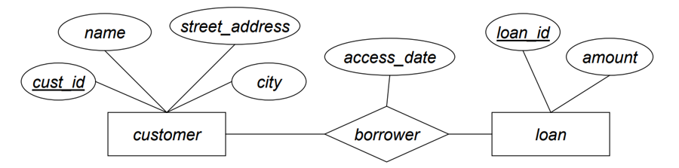
E-R diagram for customer and Loan

Slide 20
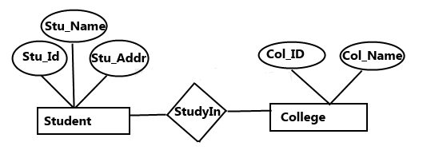
E-R diagram for student and course

Slide 21


